Slide 1
Horizon 2020
History, scope and development of the ERA-NET scheme
Jörg NIEHOFF
DG Research & Innovation
Dir. B – Innovation Union and European Research Area
Unit B2 – ERA Policy and Reform

Slide 2
P2Ps Resources, actors and modes of implementation | Competitive funding (Research funders) | Institutional funding (Research organisations) | Other programmes (variety of actors)
Transnational activities | Transnational research and innovation projects | Transnational research and innovation projects | Joint research agendas and implementation plans Transnational Mobility Common infrastructures incl. data Joint procurement …
Coordinated/ aligned national activities | National calls for proposals are aligned to P2P priorities in a coordinated way | National research priorities for (governmental) research organisations | National research agendas and implementation plans Mobility Procurement National infrastructures and access to it …
CSA
Marie Skłodowska-Curie Cofund
ERA-NET Cofund: Strong support to preparation and implementation
ERA-NET Cofund: Weak support to preparation and implementation
ESFRI
Thematic calls under H2020
PCP-PPI Cofund
Article 185 / European Joint Programme Cofund: Possible strong support to implementation for a broad range of activities
No H2020 support
COST
ERA-NET Cofund: Little support to prepa-ration, no support to implementation
CSA: Possible strong support to preparation, no support to implementation

Slide 3
ERA-NET FP6/FP7 – the principles
ERA-NET
ERA-NET
Plus
Coordination of programmes
MS agree and fund joint calls/programmes
EU funding only for coordination
New in FP7: Top up of a single joint call
MS contribute to a joint trans-national call
EU funding for research: ≤ 33% of the joint call

Slide 4
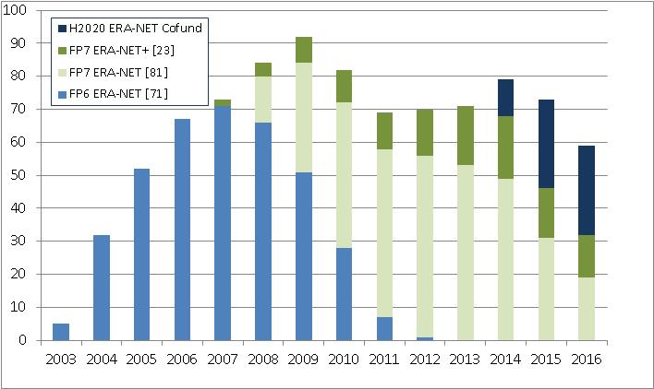
Number of running ERA-NET actions

Slide 5
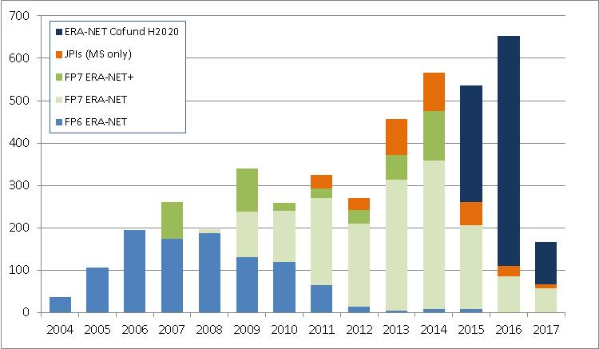
ERA-NET, ERA-NET Plus, ERA-NET Cofund and JPIs calls: total of > Euro 4 Billion by 2016

Slide 6
ERA-NETs and the funding modes they use
Real common pot
Countries pool their national contributions to a common and centrally administered call budget (Transnational flow of funding) ➔ Allows following the ranking list by avoiding any risk of mismatch between national funding contributions and requested budgets for successful proposals ➔ Very few ERA-NETs have used this model
Virtual (or distributed) common pot
Countries pay for their own participants (no trans-national flow) ➔ Successfully used by the majority of ERA-NETs
Mixed mode
Good practice: part of the budget reserved as “real common pot ➔ Allows following the ranking list ➔ Standard model for co-funded calls (ERA-NET Plus actions)
Notes:
Horizon 2020 put a clear focus on strong partnership with Member States
Reflected in Article 26 on Public-Public Partnerships
Two possibilities for support: ERA-NET Cofund and Art.185
Clear reference to Joint Programming initiatives

Slide 7
Strong leverage effect of Union contribution (Euro FP funding resulting in Euro public funding of transnational projects)
FP6 ERA-NETs 6
FP7 ERA-NETs 10
Continuation from FP6: 16
New under FP7: 7
➔ Significant differences across themes
➔ Some ERA-NETs reaching leverage effects of 50
➔ Continuity is key to success

Slide 8
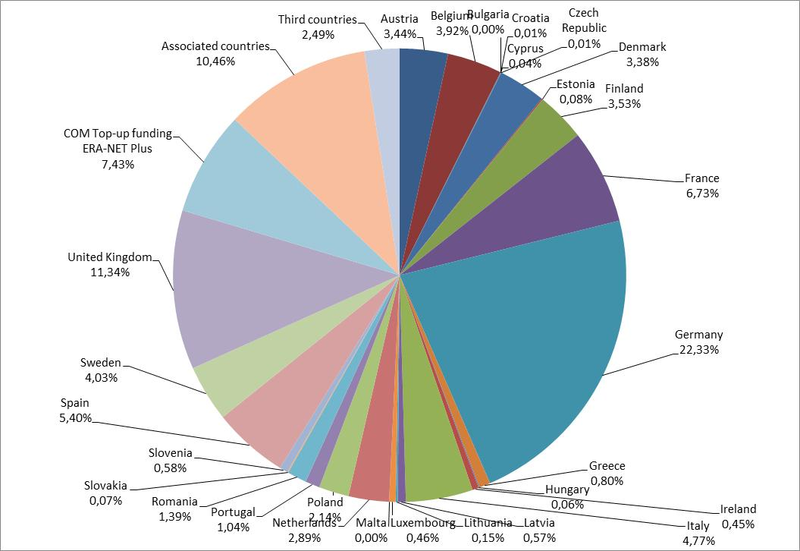
Share per MS of public funding in ERA-NET and ERA-NET Plus calls in 2009-2014 (sample)

Slide 9
FP6: ERA-NET Funding of costs related to the coordination of national research programmes, 100% reimbursement rate for coordination and management costs
FP7: ERA-NET and ERA-NET Plus ERA-NET: as under FP6 ERA-NET Plus: co-funding of a single joint call for trans-national proposals, 33% reimbursement rate for the costs of funding the projects
Horizon 2020: ERA-NET Cofund Co-funding of a single joint call for trans-national proposals, in addition other joint activities including other joint calls without Union co-funding, 33% reimbursement rate

Slide 10
ERA-NET Cofund – main features
EU contribution: mainly a proportional contribution to total public funding of the joint call
Co-funded calls: proposal evaluation and selection according to Horizon 2020 standards
Additional EU contribution to coordination costs on the basis of a unit costs for additional activities including additional calls without top-up funding
ERA-NET Cofund: implementation of a co-funded joint call for proposals (compulsory, one co-funded call per Grant Agreement)*
Stable reimbursement rate: ERA-NET Plus reimbursement rate from FP7 (33%) applies
* ERA-NETs based on a Coordination and Support Action (CSA) are no longer possible. Only in exceptional cases it might be considered to support the preparation and structuring of specific emerging P2Ps that demonstrate clear European added value.

Slide 11
A. Implementation of a single joint call (MS contribution in cash)
B. Implementation of a single joint call (MS contribution in cash) and additional activities
C. Implementation of a single joint call (MS contribution in kind)
In exceptional cases
Call for proposals organised by national/regional funding agencies
Activities: call preparation, implementation and follow-up
Eligible costs: financial support paid to third parties
Call and activities as in A.
Additional joint activities including additional joint calls without Union top-up funding.
Eligible costs: financial support paid to third parties and coordination costs for additional activities (unit costs per beneficiary per year).
Call for proposals organised by governmental research organisations
Beneficiaries carry out the projects resulting from the call themselves
Eligible costs: costs of trans-national projects on the basis of Horizon 2020 rules
In-kind contributions: non-reimbursed expenditure

Slide 12
Co-funded call: Rules for providing support to or implementation of trans-national projects (Important: these are conditions for costs to be eligible!)
The beneficiaries must
The proposals/projects must
provide financial support to trans-national projects
or
implement such projects (partially or fully) themselves
- be transnational projects (at least two independent entities from two different EU Member States or associated countries)
- be selected following a joint transnational call for proposals, two-step procedure
- be evaluated in step 2, with the assistance of at least three independent experts, on the basis of excellence, impact, quality and efficiency of the implementation
- be ranked according to the evaluation results, and selected in the order of the ranking list(s)

Slide 13
Co-funded call – conditions & deliverables
After the end of the evaluation the consortium must submit to the Commission the following:
the ranking list(s) of the projects;
the observers' report on the evaluation;
the joint selection list of the projects to be funded, and
from each consortium partner participating in the joint call, a formal and duly signed commitment on availability of funds for the selected projects.
In addition:
After the end of evaluation information on each project selected for funding (data on each participant and abstracts of the project proposal),
At the end of the action: information on each funded project (data on each participant and overview of results).
Important: The conditions for call implementation for the co-funded call do not apply to additional calls without Union top-up funding.

Slide 14
Co-funded call – practical issues
Choice of the funding mode to ensure selection according to ranking ➔ good practice: mixed mode ➔ real common pot: possible
Use of step 1 to balance requested and available funding
Possibility to use more than one call topic ➔ dedicated budgets per topics, multiple ranking lists or ➔ use expert panel to adjust scores and create single ranking list
Only proposals with identical scores at the threshold of available funding may be selected according to the availability of funds in order to maximise the number of selected projects. ➔ choice of half scores / vs. full scores
Independent expert as observer: appointed by the consortium, to assess the conformity of the implementation of the joint call and, in particular, review the proper implementation of the independent international peer review and the establishment of the ranking list of trans-national projects.
Possibility of centralised management of grant agreements
➔ Make use of good practice documented by ERA-LEARN!

Slide 15
A. Implementation of a single joint call (MS contribution in cash)
B. Implementation of a single joint call (MS contribution in cash) and additional activities
C. Implementation of a single joint call (MS contribution in kind)
In exceptional cases
Call for proposals organised by national/regional funding agencies
Activities: call preparation, implementation and follow-up
Eligible costs: financial support paid to third parties
Call and activities as in A.
Additional joint activities including additional joint calls without Union top-up funding.
Eligible costs: financial support paid to third parties and coordination costs for additional activities (unit costs per beneficiary per year).
Call for proposals organised by governmental research organisations
Beneficiaries carry out the projects resulting from the call themselves
Eligible costs: costs of trans-national projects on the basis of Horizon 2020 rules
In-kind contributions: non-reimbursed expenditure

Slide 16
ERA-NET Cofund: optional additional activities
ERA-NET Cofund consortia may carry out other activities in addition to the call receiving top-up funding.
Option is normally defined in the call text, e.g.: "Proposers are encouraged to implement other joint activities including additional joint calls without EU co-funding".
Activities have to be related to the coordination of public research and innovation programmes and should focus on the preparation and implementation of joint activities including additional calls without Union top-up funding (typical ERA-NET FP7 activities).
Additional partners might be involved which do not participate in co-funded calls.
The coordination cost for the other activities takes the form of a unit cost per beneficiary year and is limited to those beneficiaries that carry out activities that go beyond the co-funded call.
Proposers have to demonstrate the appropriateness of the overall coordination costs for the proposed additional activities.

Slide 17
ERA-NET Cofund: unit costs for additional activities
Based on historical data of a representative sample (around 30%) of the 71 ERA-NET projects under FP6 (Coordination costs declared and approved for the final payment).
7% indirect costs were deducted, extreme amounts were excluded
Resulting average amount of direct costs for coordination is EUR 29 783., which includes marginal costs for subcontracting of around 4,5%
Unit costs for coordination costs per beneficiary per year: EUR 29 000
The flat rate of 25% for indirect costs under Horizon 2020 is applied as well as the reimbursement rate applicable to ERA-NET actions (normally 33%).
Maximum reimbursement per beneficiary per year of EURO 11 962,50.
Annex WP H2020: Union contribution to coordination costs for additional activities should not exceed 20% of the total Union contribution to the project.
Beneficiaries carrying out the trans-national project themselves cannot claim coordination costs.

Slide 18
ERA-NET Cofund MGA – forms of costs
A. direct costs related to trans-national projects
A.1 Direct costs of providing financial support to third parties implementing trans-national projects
A.2 Direct costs for the implementation of trans-national projects by the beneficiaries
A.2.1 Direct personnel costs for the implementation of trans-national projects by the beneficiaries
A.2.2 Direct costs of subcontracting for the implementation of trans-national projects by the beneficiaries
A.2.3 Other direct costs for the implementation of trans-national projects by the beneficiaries
B. direct coordination costs for of additional activities (unit cost)
C. indirect costs (25% flat rate) (excluding support to third parties, subcontracting etc.)
ERA-NET "cash"
ERA-NET "in-kind"

Slide 19
Default: 2 reporting periods
ERA-NET Cofund GA Commitment: planned call budget (initial national commitments)
1st Pre-financing (10%)
2nd Pre-financing based on actual requested funding following call evaluation results 80% of EC contribution
Payment of the balance on the basis of financial support paid to third parties, according to national funding rules
Phase 1: call & evaluation
Phase 2: Transnational projects implementation
Pre-existing
consortium
Evaluation
Preparation
Publication/
Advertising
Step 2
Step 1
1st reporting period
2nd reporting period
M36: progress report
Planned budget by consortium
Selection list Formal financing commitments
Final report Funding paid

Slide 20
First indications from H2020 ERA-NETs 2014/15
 | FP7 | Horizon 2020
Number of countries per call | 10 | 15
Average call budget [Euro million] | 8,8 | 29,5
Share of EU13 - budget - participation | 5% 13% | 5% 20%
Countries participating in calls 100% > 80% > 60% | - - 3 (BE, FR, DE) | 5 (BE, ES, NL) 13 (+ AT, DK, FR, DE, IT, PL, PT, UK, NO, TR)

Slide 21
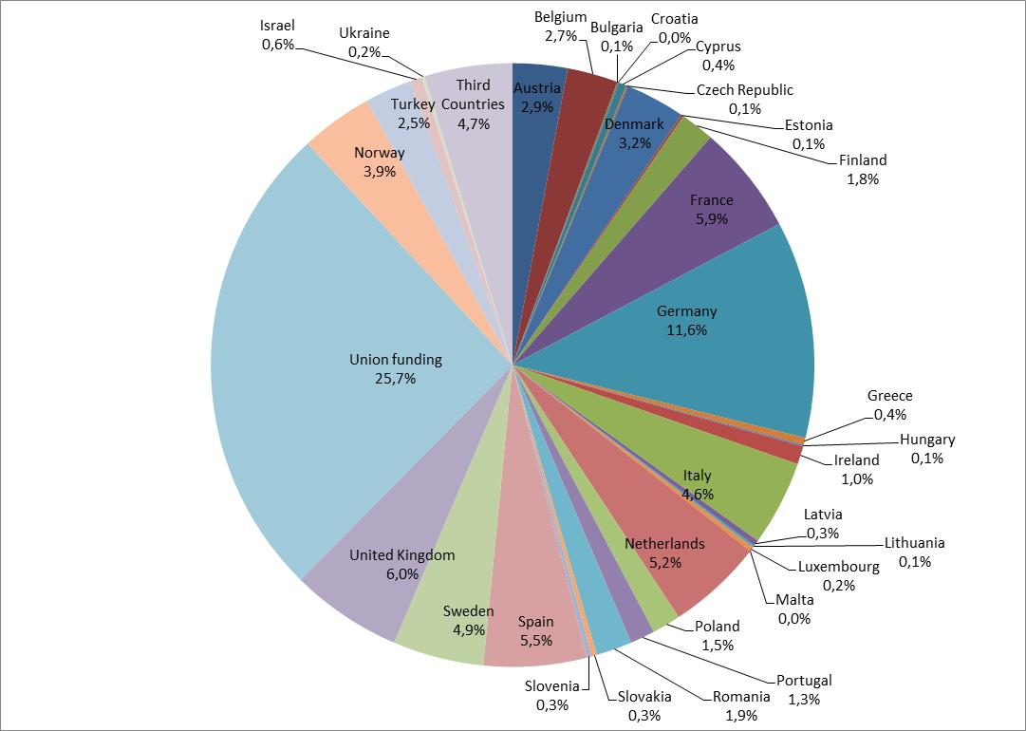
Share of public funding per country (H2020 proposals
2014/15)

Slide 22
 | ERA-NET Cofund | EJP Cofund | Art.185
Main activities | Single transnational call for proposals with Union cofunding | Direct research, demonstration and coordination activities | Multiple transnational calls for proposals
Other activities | Possibility to include additional activities incl. additional joint calls in a variable geometry | Possibility to include a limited number of calls for proposals, e.g. by including RFOs | To be defined in the basic act, if justified by the nature of the initiative
Beneficiaries / recipients of EU contribution | Typically RFOs RPOs in exceptional cases Mandated by PS | Typically RPOs RFOs in addition Mandated by PS | Designated Implementation Structure (indirect management)
Participating States (PS) contribution | Normally cash, possibility to allow for in-kind ERA-NETs with RPOs | Normally in-kind, but possibility to include cash contributions from RFOs | Defined in the basic act, normally cash, in-kind contributions if justified by the nature of the initiative
Union contribution | Reimbursement rate set at 33% | Reimbursement rate set in the WP, maximum 70% | Defined in the basic act, in most cases matching the contributions of PS
Duration | 5 years | 5 years | Typically 10 or more years, with Union contribution over up to 7 years
Establishment | WP H2020 | WP H2020 | COM Proposal incl. ex-ante Impact Assessment, Decision of Council and EP
Other issues | Can be used to prepare for Art.185 (examples: EMRP/EMPIR, BONUS) | Could be used to prepare for Art.185 | Conditional to a dedicated implementation structure Commitment for strong financial, management and scientific integration

Slide 23
Screening of P2P activities in WP 2016/17 drafts published in September 2015
ERA-NET Cofund: 2016 € 106 million, 2017: € 110 million
CSA: 2016 € 8,25 million, 2017: € 3 million, of which around € 5,25 million for JPIs in 2016
➔ All but one JPI are currently foreseen for CSA no.2
EJP Cofund: 2016 € 50 million, 2017: € 35 million
Expert Groups: € 0,62 million (Art.185 evaluations)

Slide 24
ERA-NET Cofund in WPs 2014 until 2017

Slide 25
Thank you for your attention! Any questions?
Contact
Jörg Niehoff joerg.niehoff@ec.europa.eu DG Research & Innovation Head of Sector Joint Programming Unit B2 – ERA Policy and Reforms

