Slide 1
Introduction to the ERA-LEARN 2020 platform & manual for call implementation
Roland Brandenburg, FFG
Implementing Joint Calls
Brussels, 24-25 September 2015

Slide 2
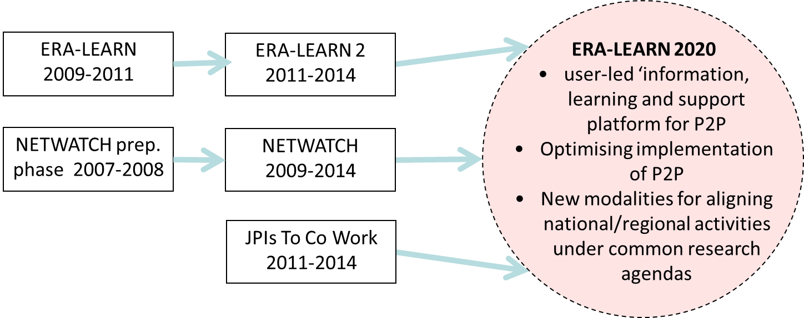
History & background
NETWATCH (JRC-IPTS): focus on database & analysis
ERA-LEARN: focus on enabling mutual learning, esp. ERA-NETs
ERA-LEARN material published through the NETWATCH portal
JPIs to co work: focus on JPI

Slide 3
ERA-LEARN 2020:
Time frame: 1/2015-12/201
1 | AT | Austrian Research Promotion Agency | FFG
2 | AT | Austrian Institute of Technology | AIT
3 | DE | EU-Bureau of the BMBF (EUB) at PT-DLR | DLR
4 | DE | VDI/VDE Innovation + Technik GmbH | VDI
5 | FI | Academy of Finland | AKA
6 | FR | Institut National de la Recherche Agronomique | INRA
7 | IE | Enterprise Ireland | EI
8 | IT | Ministry of Education, University and Research | MIUR
9 | NO | Research Council of Norway | RCN
10 | UK | Optimat | Optimat
11 | UK | Manchester Institute of Innovation Research | UNIMAN

Slide 4
ERA-LEARN 2020: Consortium of funding organisations and specialists for analysis
 | Number of ERA-NET participations | Number of JPI participations | Number of Art.185 participations | National funding organisation | Specialist in analysis
1/FFG | 48 | 1 | 2 | Y
2/AIT |  |  |  |  | Y
3/DLR | 33 | 2 | 2 | Y
4/VDI | 5 | 2 | 1 | Y | Y
5/AKA | 44 | 6 | 1 | Y
6/INRA | 12 | 2 | 0 | Y
7/EI | 12 | 3 | 2 | Y
8/MIUR | 18 | 4 | 2 | Y
9/RCN | 71 | 10 | 3 | Y
10/Optimat |  |  |  |  | Y
11/UNIMAN |  |  |  |  | Y
Notes:
consortium members participate(d) in >300 networks

Slide 5
ERA-LEARN 2020: Objectives
provide a web-based information, learning and support platform for P2P;
support the ongoing optimisation of P2P networks by expanding the ERA-LEARN toolbox to include the wider activities of joint programming, particularly the ERA-NET Cofund, Art.185, JPIs
implement a systematic process for monitoring & impact assessment of P2P networks, including their impacts at both the policy, programme and co-funded RTD project-level;
assess and benchmark current approaches to alignment and explore options for new modalities that will better align national and/or regional activities under common research agendas;
implement an annual cycle of knowledge exchange aimed at increasing the impact of investment in P2P activities and exploring options to support less research intensive countries.

Slide 6
ERA-LEARN 2020: Impact
Increased efficiency of public administration & policy learning
Increased awareness of joint programming and establishment of added value
Improved understanding of the joint programming approach to policy making and
implementation and development of common approaches
Higher standards and increased effectiveness of joint programming activities

Slide 7
The ERA-LEARN web-based platform
launched July 2015
database
tools & guidance
analysis

Slide 8
The ERA-LEARN toolbox: P2P in H2020
Horizon 2020 calls for P2Ps
WP 2014 & 2015: ERA-NET Cofund & CSA
WP 2016 & 2017: ERA-NET Cofund & CSA –to come soon incl partner search tool
ERA-NET Cofund under Horizon 2020: background information practical documentation
financial details, model GA, model CA, ….
Practical documentation: support for proposal preparation, consortium management

Slide 9
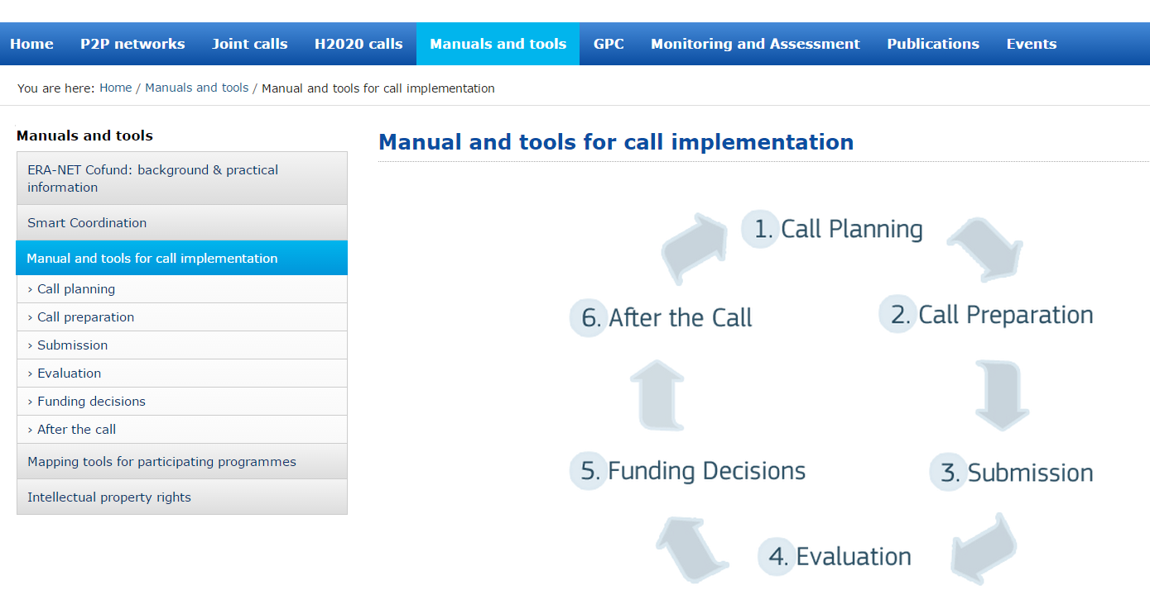
The ERA-LEARN Manual for call implementation:
… to provide practical advice on joint calls

Slide 10
The ERA-LEARN Manual for call implementation
Top priority: easy to use -not another large pdf document
Call implementation requires thinking ahead and corresponding planning in advance → many crosslinks between the elements of the call cycle
Module structure is suitable for quick updates and extensions
→ Interactive online manual is a convenient solution

Slide 11
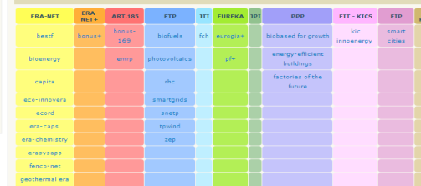
The ERA-LEARN toolbox:
Smart Coordination: ERA instruments
… to provide an introduction to ERA instruments (target groups, implementation, legal structure and funding sources)
… to analyse trends & experiences with transnational programme coordination
Thematic clustering of ERA initiatives:
Are we aware of all initiatives in a certain thematic area ?
What can we learn from them?
Who is involved ?
Positioning of the ERA-NET scheme in the context of other ERA instruments and other initiatives
Criteria and indicators for the assessment of coordination-instruments and intergovernmental European networks
Inventory of ERA instruments

Slide 12
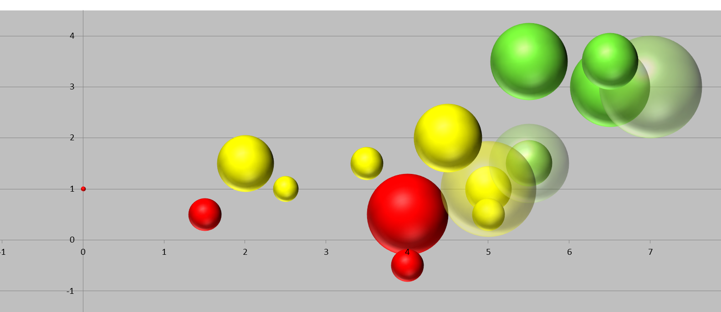
The ERA-LEARN toolbox
Tools for internal review of ERA(-NET) participation
do we participate in adequate transnational initiatives that fit our strategies ?
do we use our resources reasonably ?
output
network

Slide 13
The ERA-LEARN web-based platform:
more material
database of networks and calls
H2020 topics
analysis
publications
→ continuous updates
→ interaction with the community

Slide 14
Dissemination and Exploitation: past and future events & publications
to involve the whole (ERA-NET) community
to facilitate communication, information sharing and best practice exchange
Annual ERA-NET event «ERA-NETs on stage», Brussels, 2008, 2009, 2010
ERA-LEARN workshop «Implementing Joint Calls», Berlin, March 2010
EC / ERA-LEARN Strategy Workshop «Innovation Union - Joint Programming and its instruments», Brussels, Apr 2011
Annual Joint Programming Event, Brussels, Nov 2011
ERA-LEARN workshop «Implementing Joint Calls», Brussels, Nov 2011
EC / ERA-LEARN Workshop “The future ERA-NET instrument under H2020», Brussels, June 2012
ERA-LEARN Workshop «Addressing the needs of the mature trans-national coordination community», Dublin, Feb 2013
ERA-LEARN workshop «Implementing Joint Calls», Brussels, Sep 2013, Jan 2014, Sep 2014, Sep 2015
Annual Joint Programming Conference, Brussels, Nov 2015
Newsletters since 2011

Slide 15
Contact
Roland Brandenburg
FFG Austrian Research Promotion Agency
office@era-learn.eu
www.era-learn.eu

